Slide 1

Movie Database Analysis
Fall 24 CDS 302
Heeseung Moon, Junghoon Choi, Heewon Yang, Wonbin Shin

Slide 2
Table of Contents
Introduction
E-R modeling
Relational Database Design
SQL Research
Conclusion

Slide 3

Introduction- Background
The movie industry in U.S is famous and loved by most movie lovers.
Our Database Management System look through movies.
When many people was asked about movie,
Actors and Directors come out first.
There are more component in the movie.
Our Team will describe how movie looks like.
image crediet: https://classe-internationale.com/2024/02/24/hollywood-the-epitome-of-the-united-states-global-power/

Slide 4
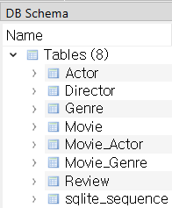
Introduction- Data Preview
1. Scanning Data
BoxOfficeCollections.csv: Box Office which is about sells
Director.csv: Director
Genre.csv: Genre
names.csv: Current Actors
OldActor.csv: Old famous actors
rating_rottentomatto.csv: Famous movie Review organization
titles.csv: Titles of movie

Slide 5
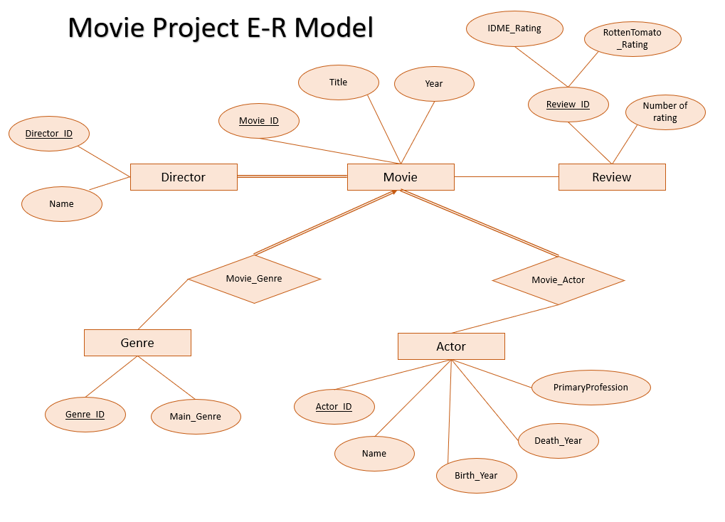
2. E-R modeling
Part 1
Entity-Relationship model Summary
Five Entities
1. Movie
2.Director
3.Genre
4.Actor
5.Review
Two Relationship
1.Movie_Genre
2.Movie_Actor

Slide 6
2. E-R modeling
Part 2 Cardinality Summary
 | Relationship | Cardinality | Key
1 | Director - Movie | One to Many (1:N) | Director_ID as a Foreign Key (FK) in the Movie table
2 | Movie - Actor | Many to Many (N:M) | Implemented via the Movie_Actor table
3 | Movie - Genre | Many to Many (N:M) | Implemented via the Movie_Genre table
4 | Movie - Review | One to Many (1:N) | Movie_ID as a Foreign Key (FK) in the Review table

Slide 7
2. E-R modeling
Part 2 Cardinality Summary
Director
Director_ID
Name
Movie
Movie_ID
Title
Year
direct
Director — Movie
Cardinality: One - to -Many (1:N)
A single director can direct multiple movies, but each movie has only one director.

Slide 8
2. E-R modeling
Part 2 Cardinality Summary
Actor
Actor_ID
Name
Birth
Death
Movie
Movie_ID
Title
Year
feature
2. Actor — Movie
Cardinality: Many - to - Many (N:M)
A single movie can feature multiple actors, and each actor can appear in multiple movies.

Slide 9
2. E-R modeling
Part 2 Cardinality Summary
Genre
Main Genre
Movie
Movie_ID
Title
Year
belong to
3. Genre — Movie
Cardinality: Many - to -Many (N:M)
A single movie can belong to multiple genres, and each genre can include multiple movies.

Slide 10
2. E-R modeling
Part 2 Cardinality Summary
Reviews
Director - Movie
Movie - Actor
Movie - Genre
Movie - Review
Movie
Movie_ID
Title
Year
have
4. Movies — Reviews
Cardinality: One - to -Many (1:N)
A single movie can have multiple reviews, but each review is linked to only one movie.

Slide 11
3. Relational Database Design
Part 1: Relational Schemas
Simplified Schema from E-R model
Movie (Movie_ID, Title, Year, IMDB_Rating, Metascore, Box_Office, Time_Minute, Votes, Director_ID)
Director (Director_ID, Name, Country, Birth_Year, Death_Year)
Actor (Actor_ID, Name, Birth_Year, Death_Year, Primary_Profession)
Genre (Genre_ID, Main_Genre)
Review (Review_ID, Movie_ID, RatingTomatometer, Number_of_Reviews)
Movie_Actor (Movie_ID, Actor_ID)
Movie_Genre (Movie_ID, Genre_ID)

Slide 12
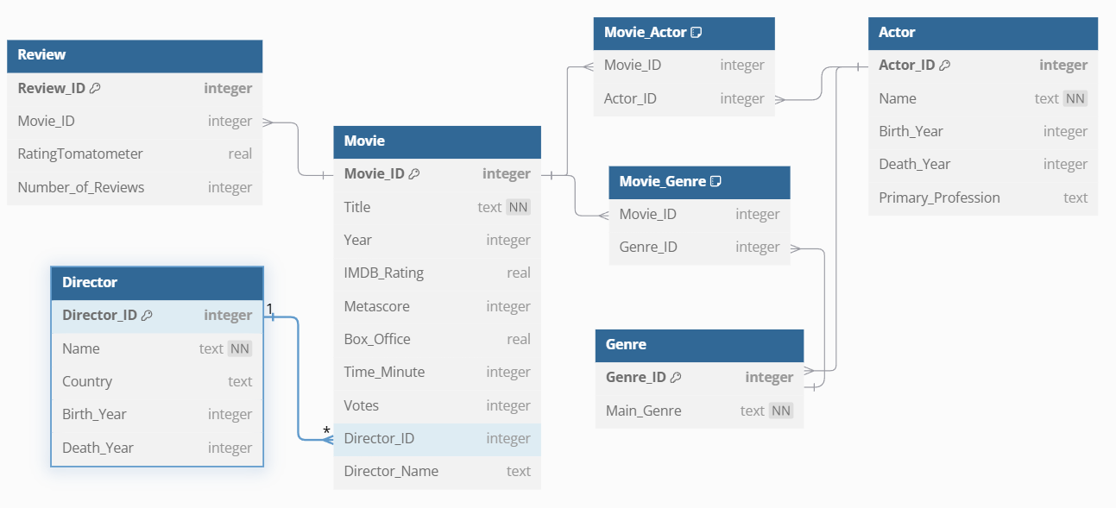
3. Relational Database Design
Part 1: Relational Schemas
dbdiagram.io

Slide 13
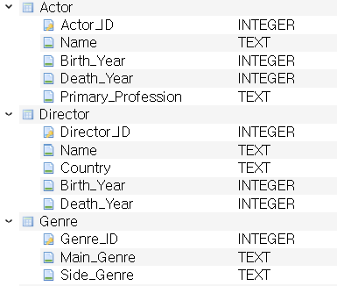
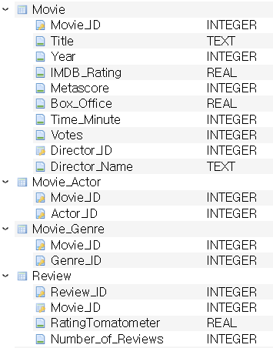
3. Relational Database Design
Part 2: Actual Tables

Slide 14
3. Relational Database Design
Part 3: Foreign Key Relationships
(Movie)Director_ID → (Director)Director_ID: Links each movie to its director.
(Review)Movie_ID →( Movie)Movie_ID: Links each review to the movie it evaluates.
(Movie_Actor)Movie_ID → (Movie)Movie_ID: Connects a movie to the actors that appear in it.
(Movie_Actor)Actor_ID → (Actor)Actor_ID: Connects an actor to the movies they act in.
(Movie_Genre)Movie_ID → (Movie)Movie_ID: Links a movie to its genres.
(Movie_Genre)Genre_ID → (Genre)Genre_ID: Connects a genre to the movies it applies to.

Slide 15
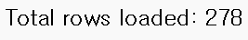
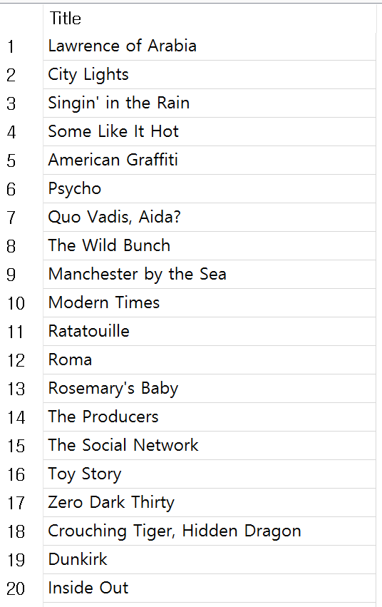
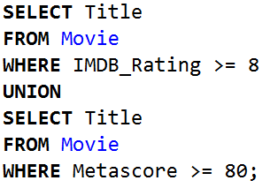
4. SQL Research (Set Operations)
Q: List the titles of movies with an IMDb rating of 8 or higher, or a Metascore of 80 or higher.

Slide 16
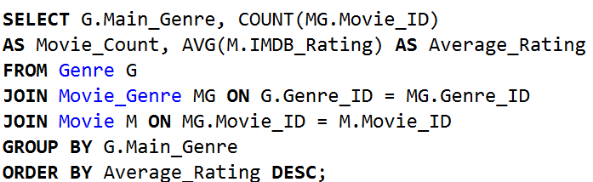
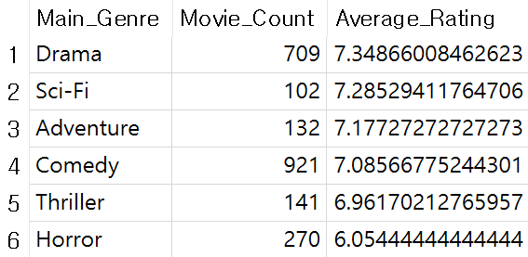
4. SQL Research (Aggregate Functions)
Q: Calculate the number of movies and average IMDb rating for each genre.

Slide 17
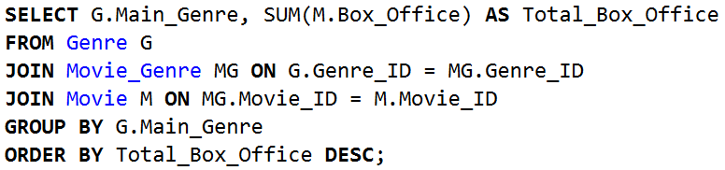
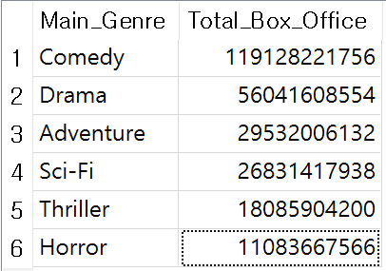
4. SQL Research (Ordering and Grouping)
Q: List the genres by total box office earnings, sorted in descending order.

Slide 18
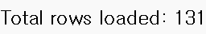
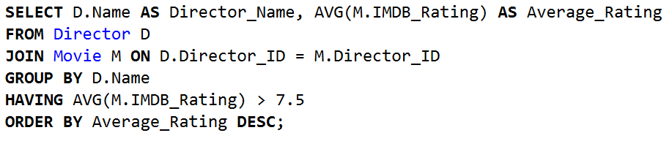
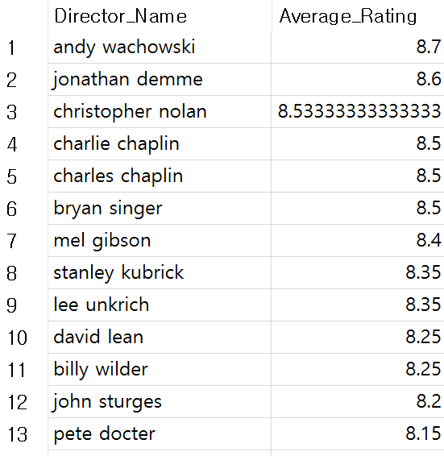
4. SQL Research (HAVING Clause)
Q: Who are the directors with an average movie IMDb rating above 7.5?

Slide 19
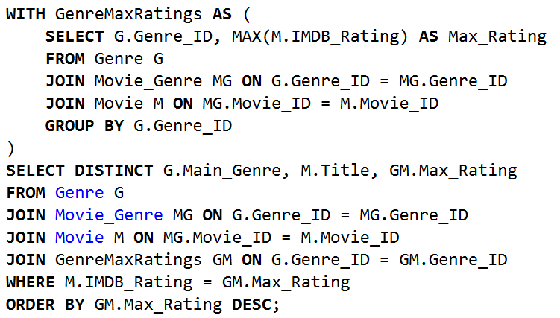
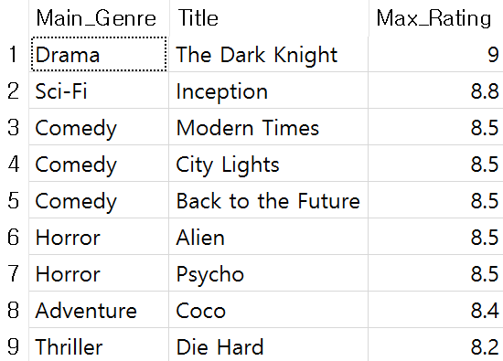
4. SQL Research (WITH Clause)
Q: What is the highest-rated movie in each genre?

Slide 20


5. Conclusion
Genre | Average Rating
Drama | 7.35
Science Fiction | 7.29
Director | Average Rating
Andy Wachowski | 8.7
Jonathan Demme | 8.6
Christopher Nolan | 8.5

Slide 21


5. Conclusion
Title | Rating
Dark Knight(Drama) | 9
Inception (Science Fiction) | 8.8

Slide 22

Any Questions?

Slide 23
Thank you

